Slide 1
Net 222: Communications and networks fundamentals (Practical Part)
Tutorial 5: Chapter 8 Data & computer communications

Slide 2
Chapter 8 pages 271 (Data & computer communications)
Problems:
8.1 (a)
8.9
8.11(b)
8.13

Slide 3
Question
8.1 The information in four analog signals is to be multiplexed and transmitted over a telephone channel that has a 400- to 3100-Hz bandpass. Each of the analog baseband signals is bandlimited to 500 Hz. Design a communication system (block diagram) that will allow the transmission of these four sources over the telephone channel using
a. Frequency division multiplexing
Show the block diagrams of the complete system, including the transmission, channel, and reception portions. Include the bandwidths of the signals at the various points in the systems.

Slide 4
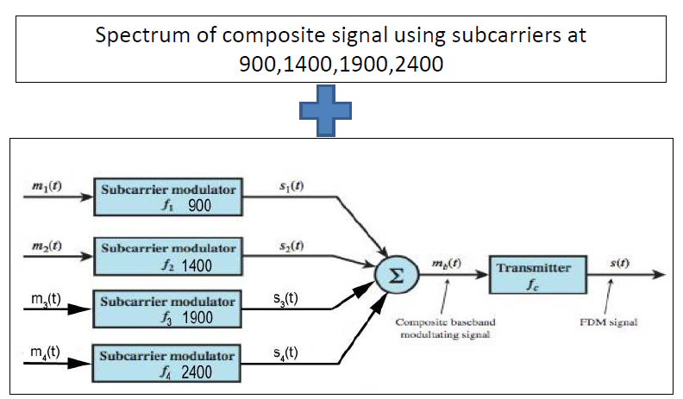
Answer

Slide 5
Question
8.9 Twenty-four voice signals are to be multiplexed and transmitted over twisted pair. What is the bandwidth required for FDM?
NOTE: Assume that the voice signal frequency is 4 KHz.

Slide 6
Answer
The required bandwidth for FDM is 24 × 4 = 96 kHz.

Slide 7
Question
8.11 A time division multiplexer is used to combine the data streams of a number of terminals, each terminal needs 110-bps for data transmission over a 2400-bps digital line. Assume that at least 3% of the line capacity is reserved for some uses.
b. Determine the number of terminals that can be accommodated by the multiplexer.

Slide 8
Answer
Available capacity = 2400 bps - 3%
=2400 – (2400 - 3%)
= 2328 bps
OR 2400 – (2400 – 3/100)= 2328 bps
Number of terminals =2328/110=21.6=21 terminals

Slide 9
Question
8.13 Ten 9600-bps lines are to be multiplexed using TDM. What is the total capacity required for synchronous TDM?

Slide 10
Answer
Total capacity = 9600 bps × 10 =96000 bps
=96 kbps

Slide 11
The End
Any Questions ?

